Slide 1

Optimizing Inventory for Growth: Data-Driven Insights for T.T Inc.
By Nathalie Iredje

Slide 2
Table of Content
Business Overview
Business problems & Objectives
Data Analysis & Findings : SQL Queries, Insights & Recommendations
4. Action Plans
5. Conclusion

Slide 3
Business Overview
T.T Inc. is a leading company known for its innovative consumer electronics. They make a wide range of products, from home appliances, electronics to laptops. As T.T Inc. grows, it's really important to manage their inventory well to stay profitable and keep customers happy. This presentation looks at key data insights from T.T Inc.'s sales and inventory records. These insights will help create a strong inventory plan for the next year.

Slide 4
Business Problems
Objectives of this Analysis
Too Much or Too Little Stock: T.T Inc. sometimes has too much inventory (which costs money to store) or not enough inventory (which means missed sales and unhappy customers).
Predicting What Customers Want: It's hard for T.T Inc. to know exactly what customers will buy, especially because of seasonal trends and the economy. This makes it difficult to plan inventory.
Efficient Operations: T.T Inc. wants to make its inventory processes smoother and more efficient to save money and resources.
Find the Right Amount of Inventory: Develop data-driven ways to avoid having too much or too little stock.
Understand Sales Trends: Figure out seasonal patterns and what's popular for different products to better predict demand.
Make Sure Products Are Available: Keep enough stock on hand so customers can always find what they need.
Improve Inventory Management: Make inventory processes more efficient to cut costs and use resources wisely.
Use these data insights to help T.T Inc. create a better supply chain strategy for next year.

Slide 5

Data Analysis & Findings : SQL Queries, Insights & Recommendations

Slide 6
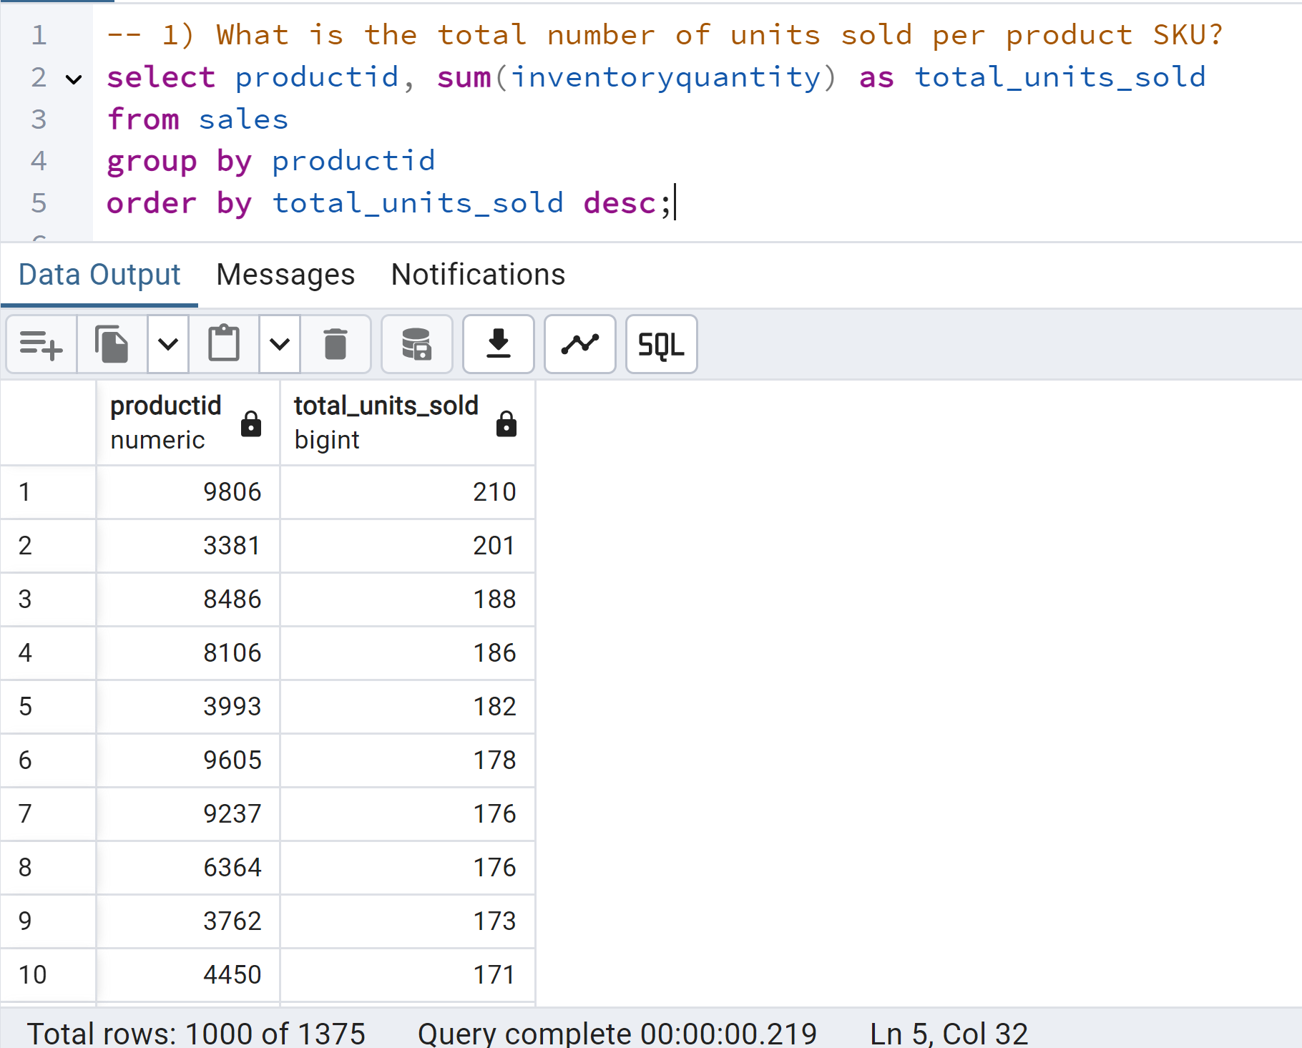
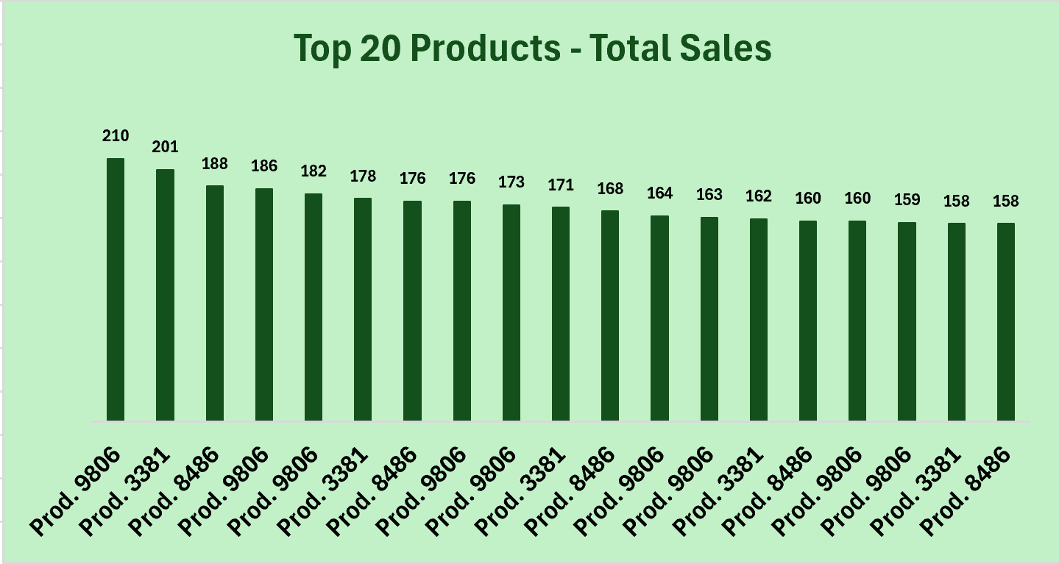
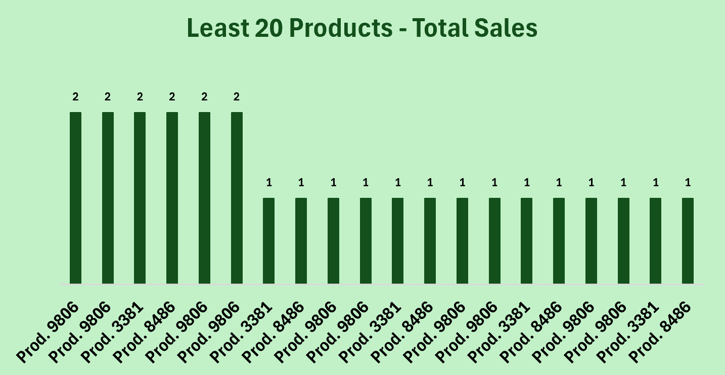
Question 1: What is the total number of units sold per product SKU?
Insights: (i) Big Sales Differences: Some products sell a lot, others barely at all. This indicates that some products are incredibly popular while some are not doing well at all(ii) Many Low Sellers: Lots of products have very low sales.
Recommendations: (i) Review Products: Look at the low sellers and consider stopping some. (ii) Group Inventory: Use A, B, C groups to manage inventory. (iii) Check Stock: Make sure there's enough of the top sellers.

Slide 7
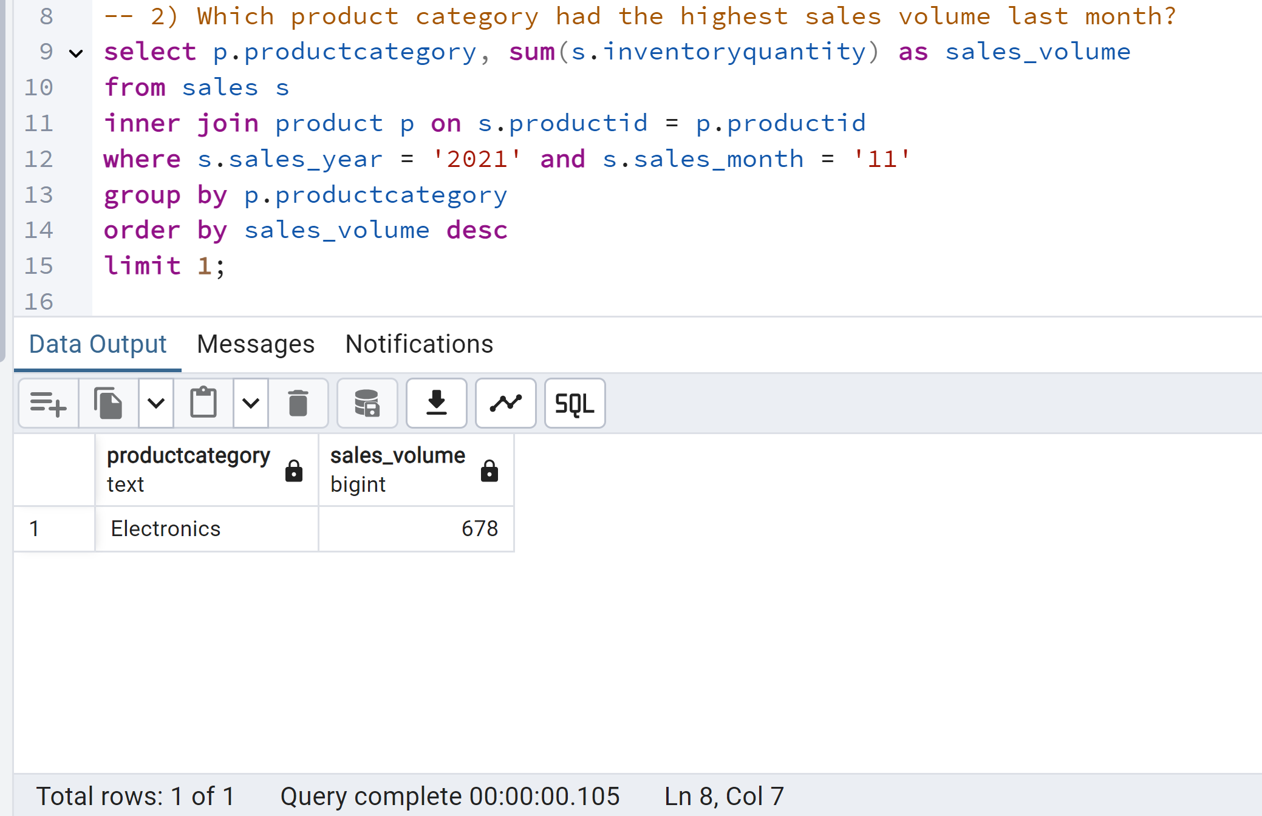
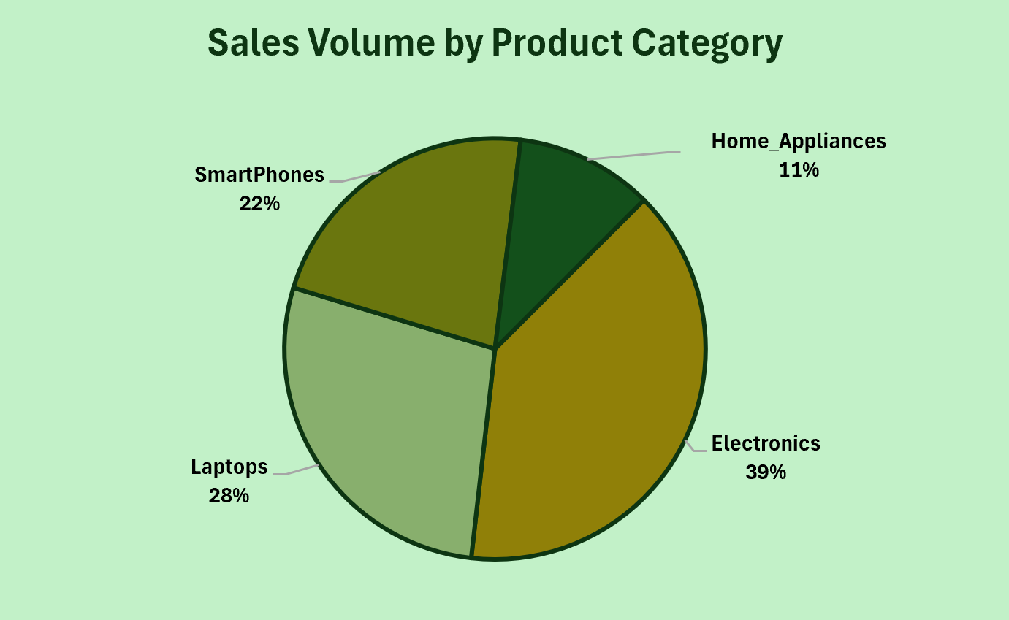
Question 2: Which product category had the highest sales volume last month?
Insights: Electronics are the top seller in November, likely due to seasonal shopping events such as black Friday, cyber monday. This category is a key revenue driver for T.T Inc.
Recommendations: (i) Ensure sufficient electronics inventory to meet peak November demand. (ii) Run targeted promotions for electronics during November. (iii) Analyse top-selling electronics subcategories for focused efforts. (iv) Investigate performance of other categories in November. (v) Compare November sales to past data for trend analysis.

Slide 8
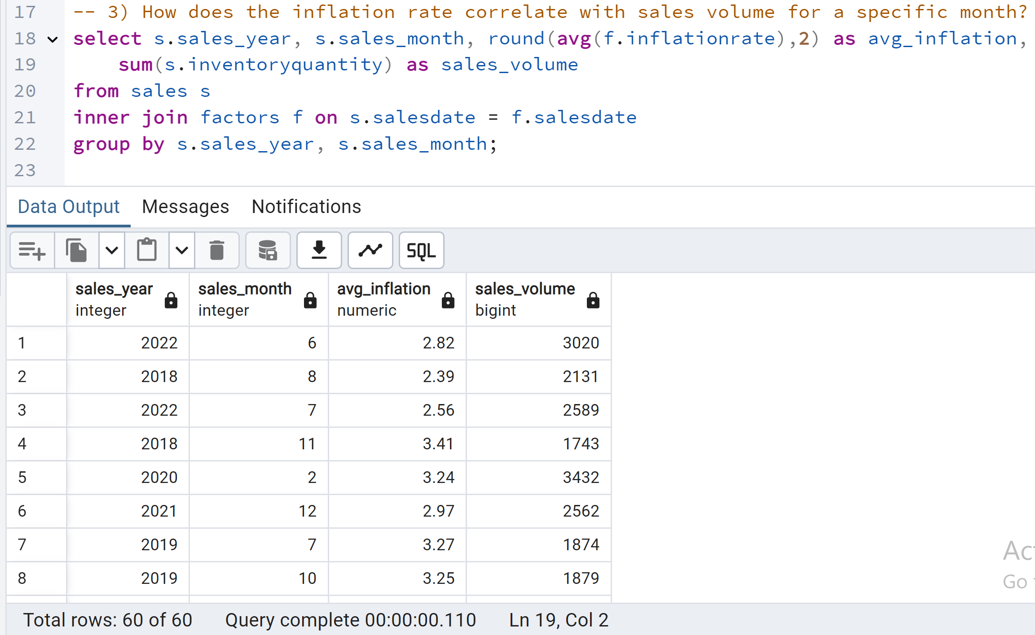
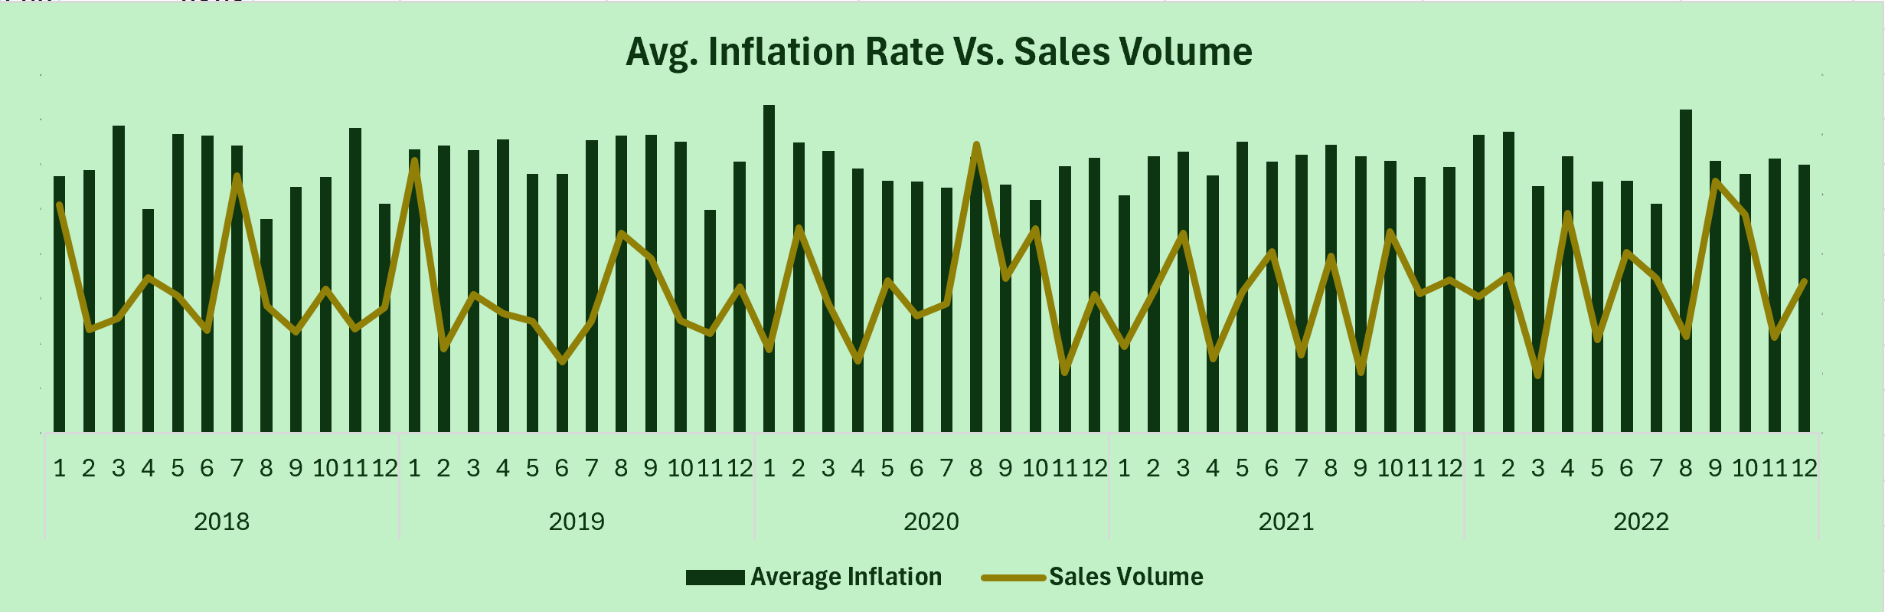
Question 3: How does the inflation rate correlate with sales volume for a specific month?
Insights: (i) No clear, consistent correlation between inflation and sales volume is immediately apparent. (ii) Other factors likely influence sales, masking any direct inflation impact.
Recommendations: The inflation-sales relationship requires further analysis to isolate its impact and inform accurate forecasting.

Slide 9
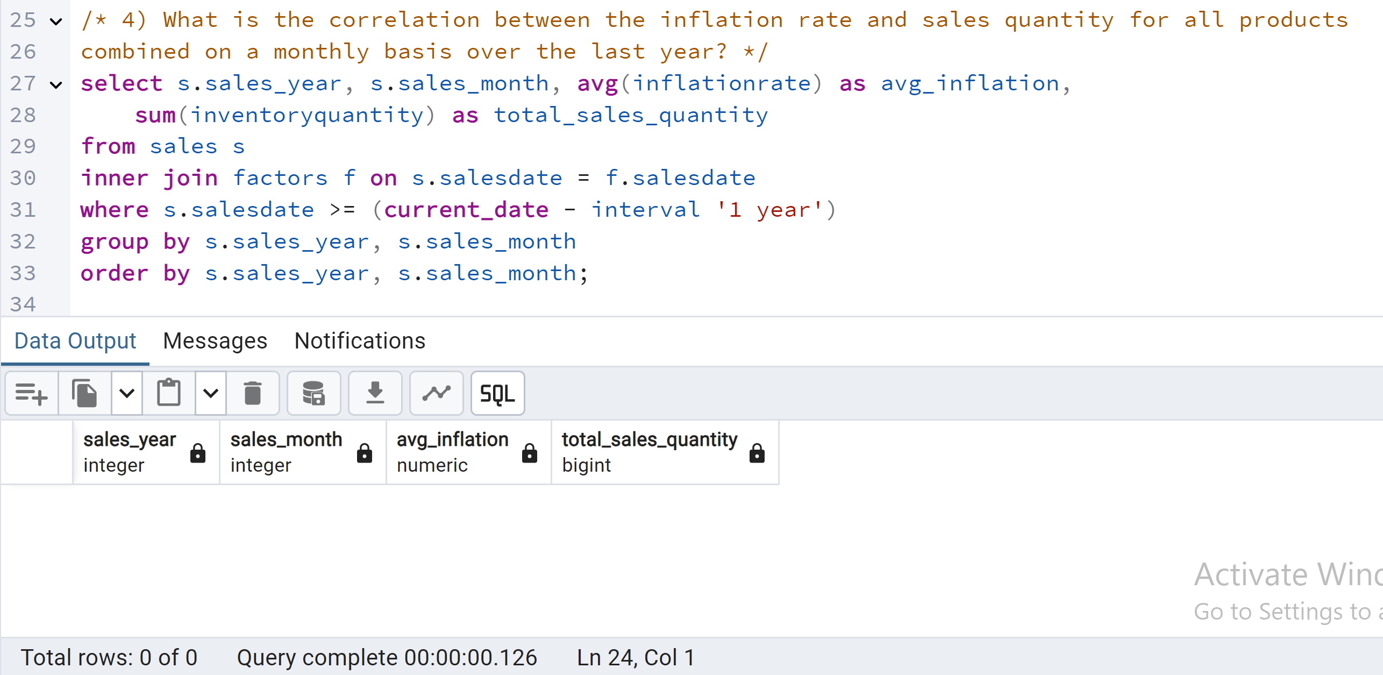
Question 4: What is the correlation between the inflation rate and sales quantity for all products combined on a monthly basis over the last year?
Insights: There is no correlation between inflation and sales volume for all products over the last year.

Slide 10
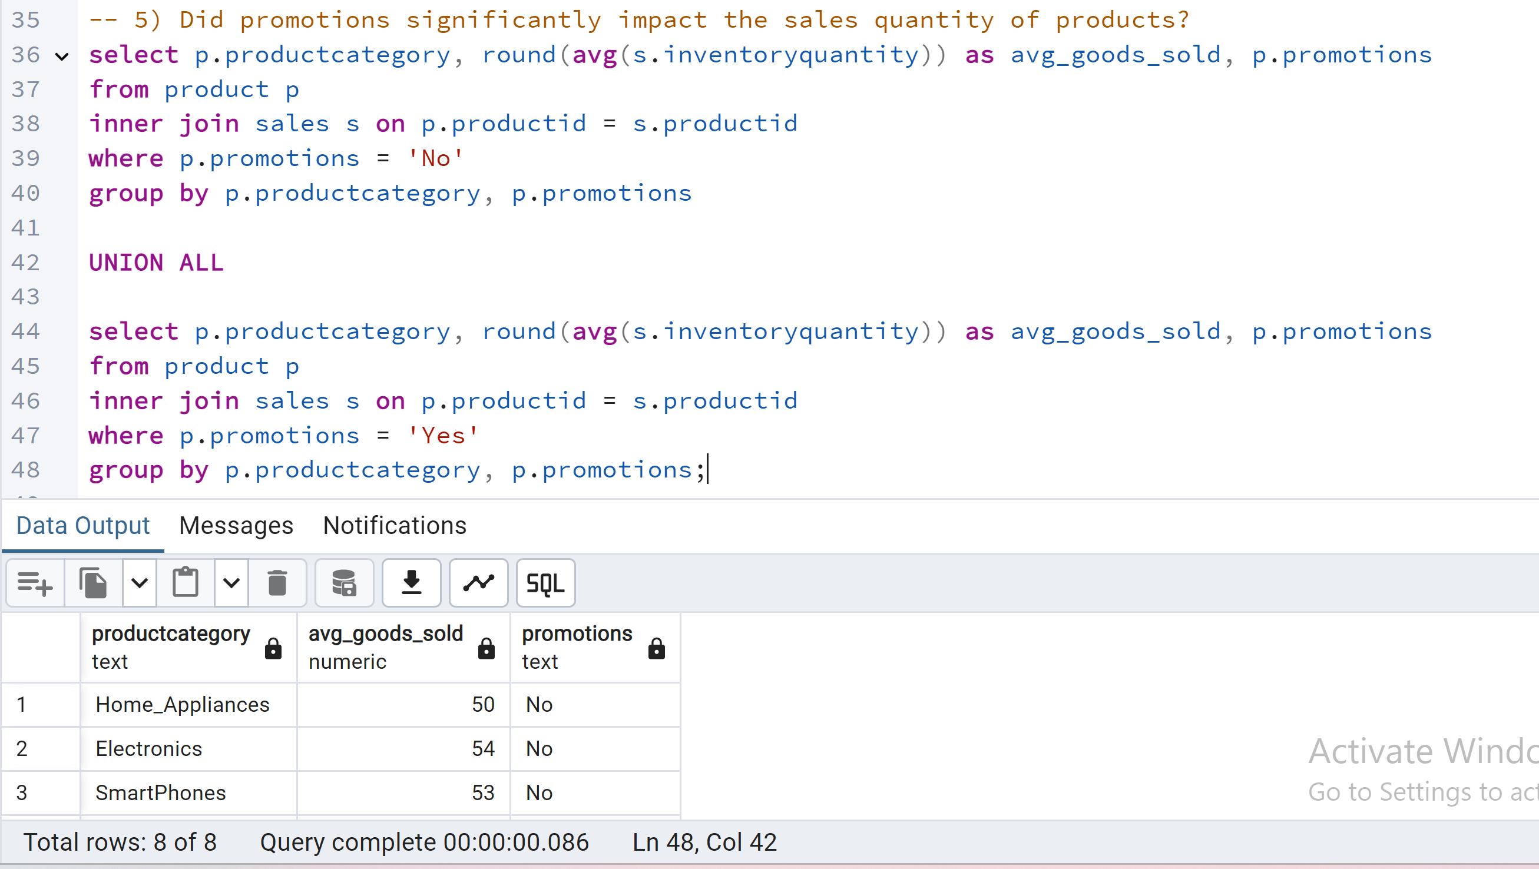
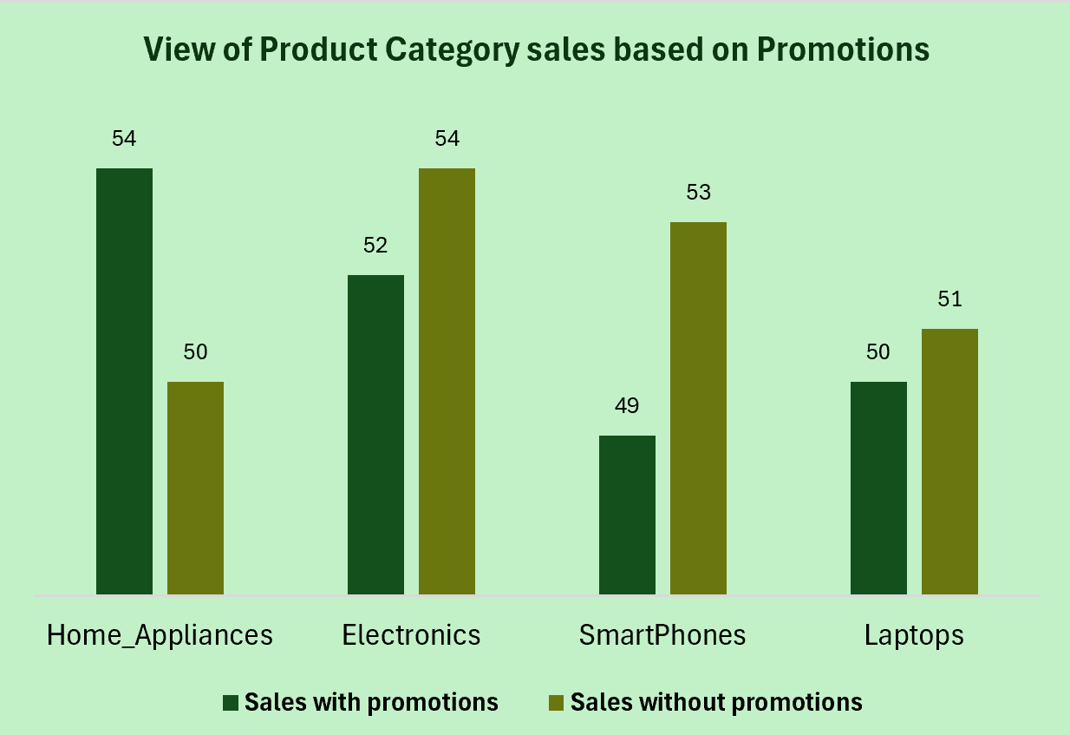
Question 5: Did promotions significantly impact the sales quantity of products?
Insights: (i) Promotions significantly boosted Home Appliance sales, suggesting category-specific effectiveness. (ii) Other categories showed minimal or negative promotion impact.
Recommendations: (i) Prioritize targeted Home Appliance promotions. (ii) Experiment with varied promotion types/timing for other categories. (iii) Develop category-specific promotion strategies.

Slide 11
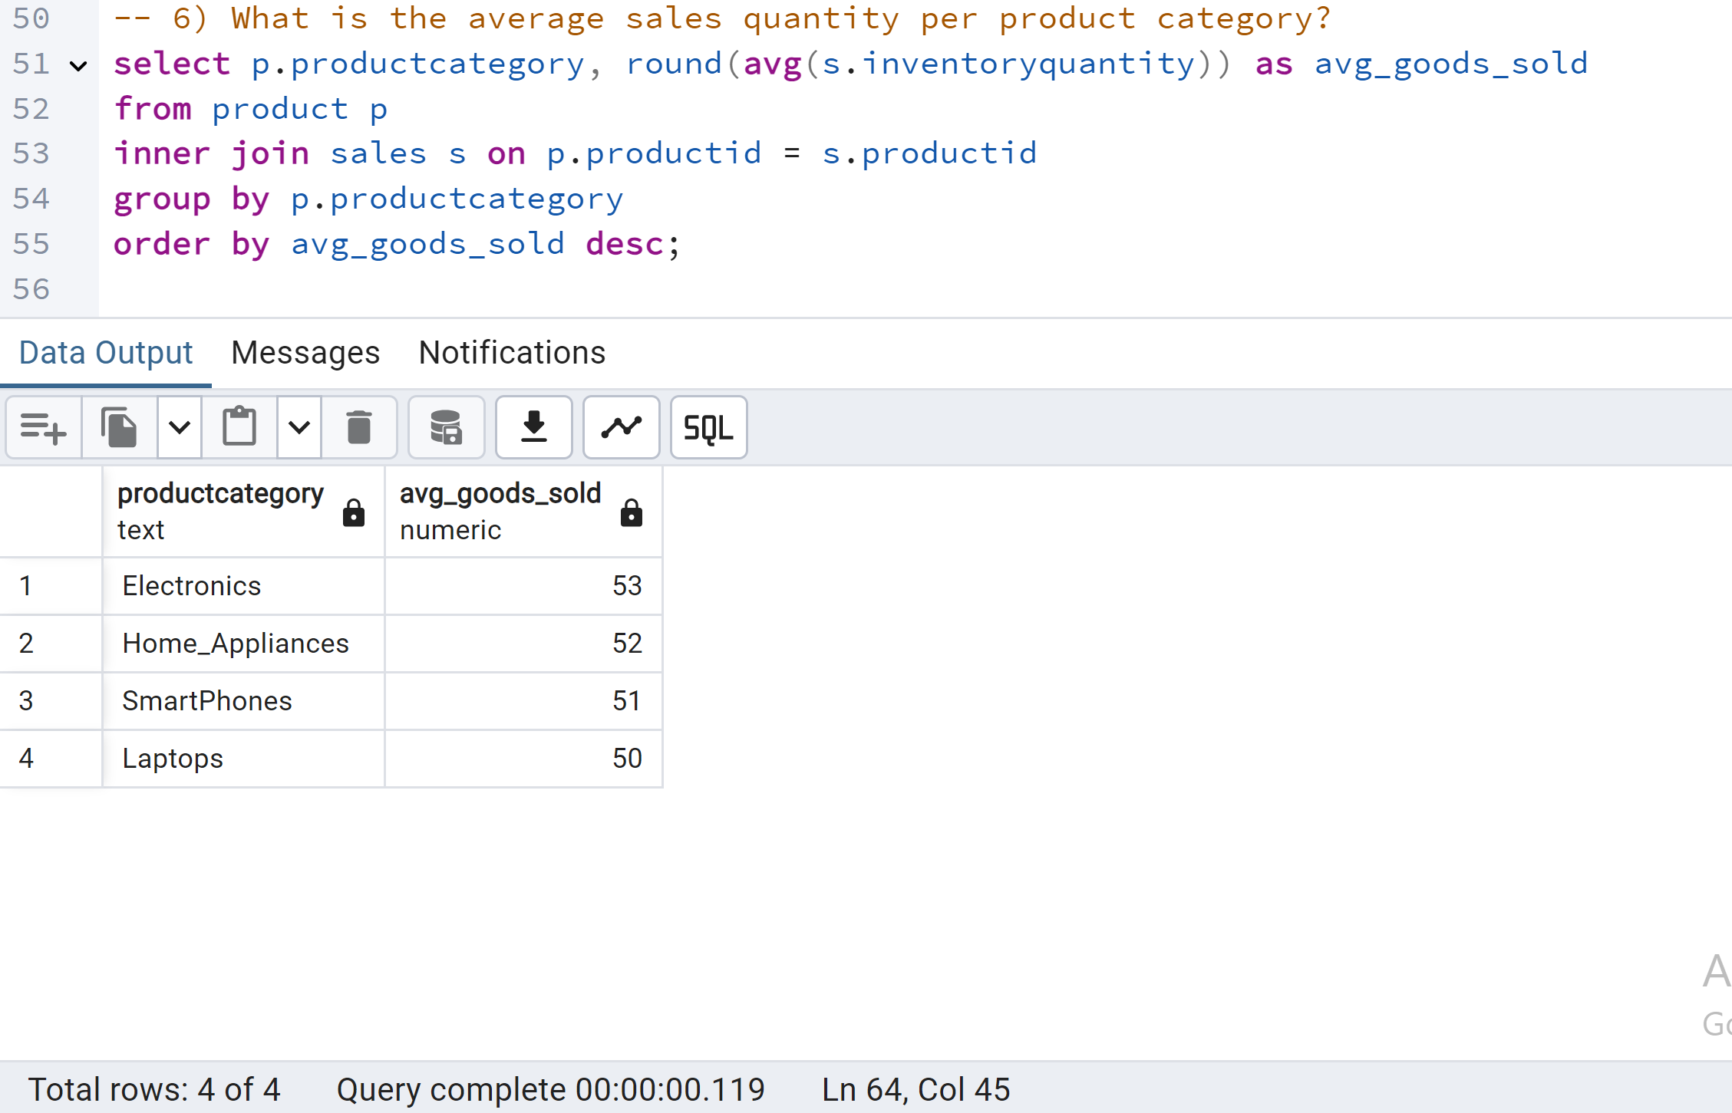
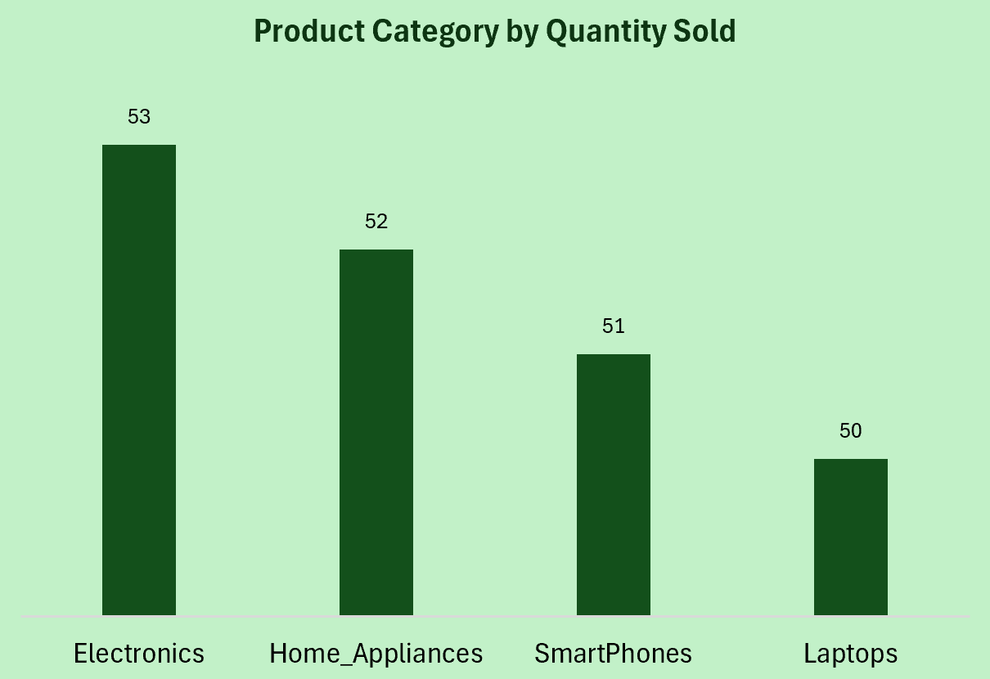
Question 6: What is the average sales quantity per product category?
Insights: (i) Average sales quantity were very similar across all categories with electronics slightly leading. (ii) This suggests there is a stable demand for products in all product categories.
Recommendations: (i) Ensure balanced inventory levels across all categories to meet consistent demand and avoid stockouts. (ii) Conduct deeper analysis within each category to identify top-selling products and potential areas for improvement.

Slide 12
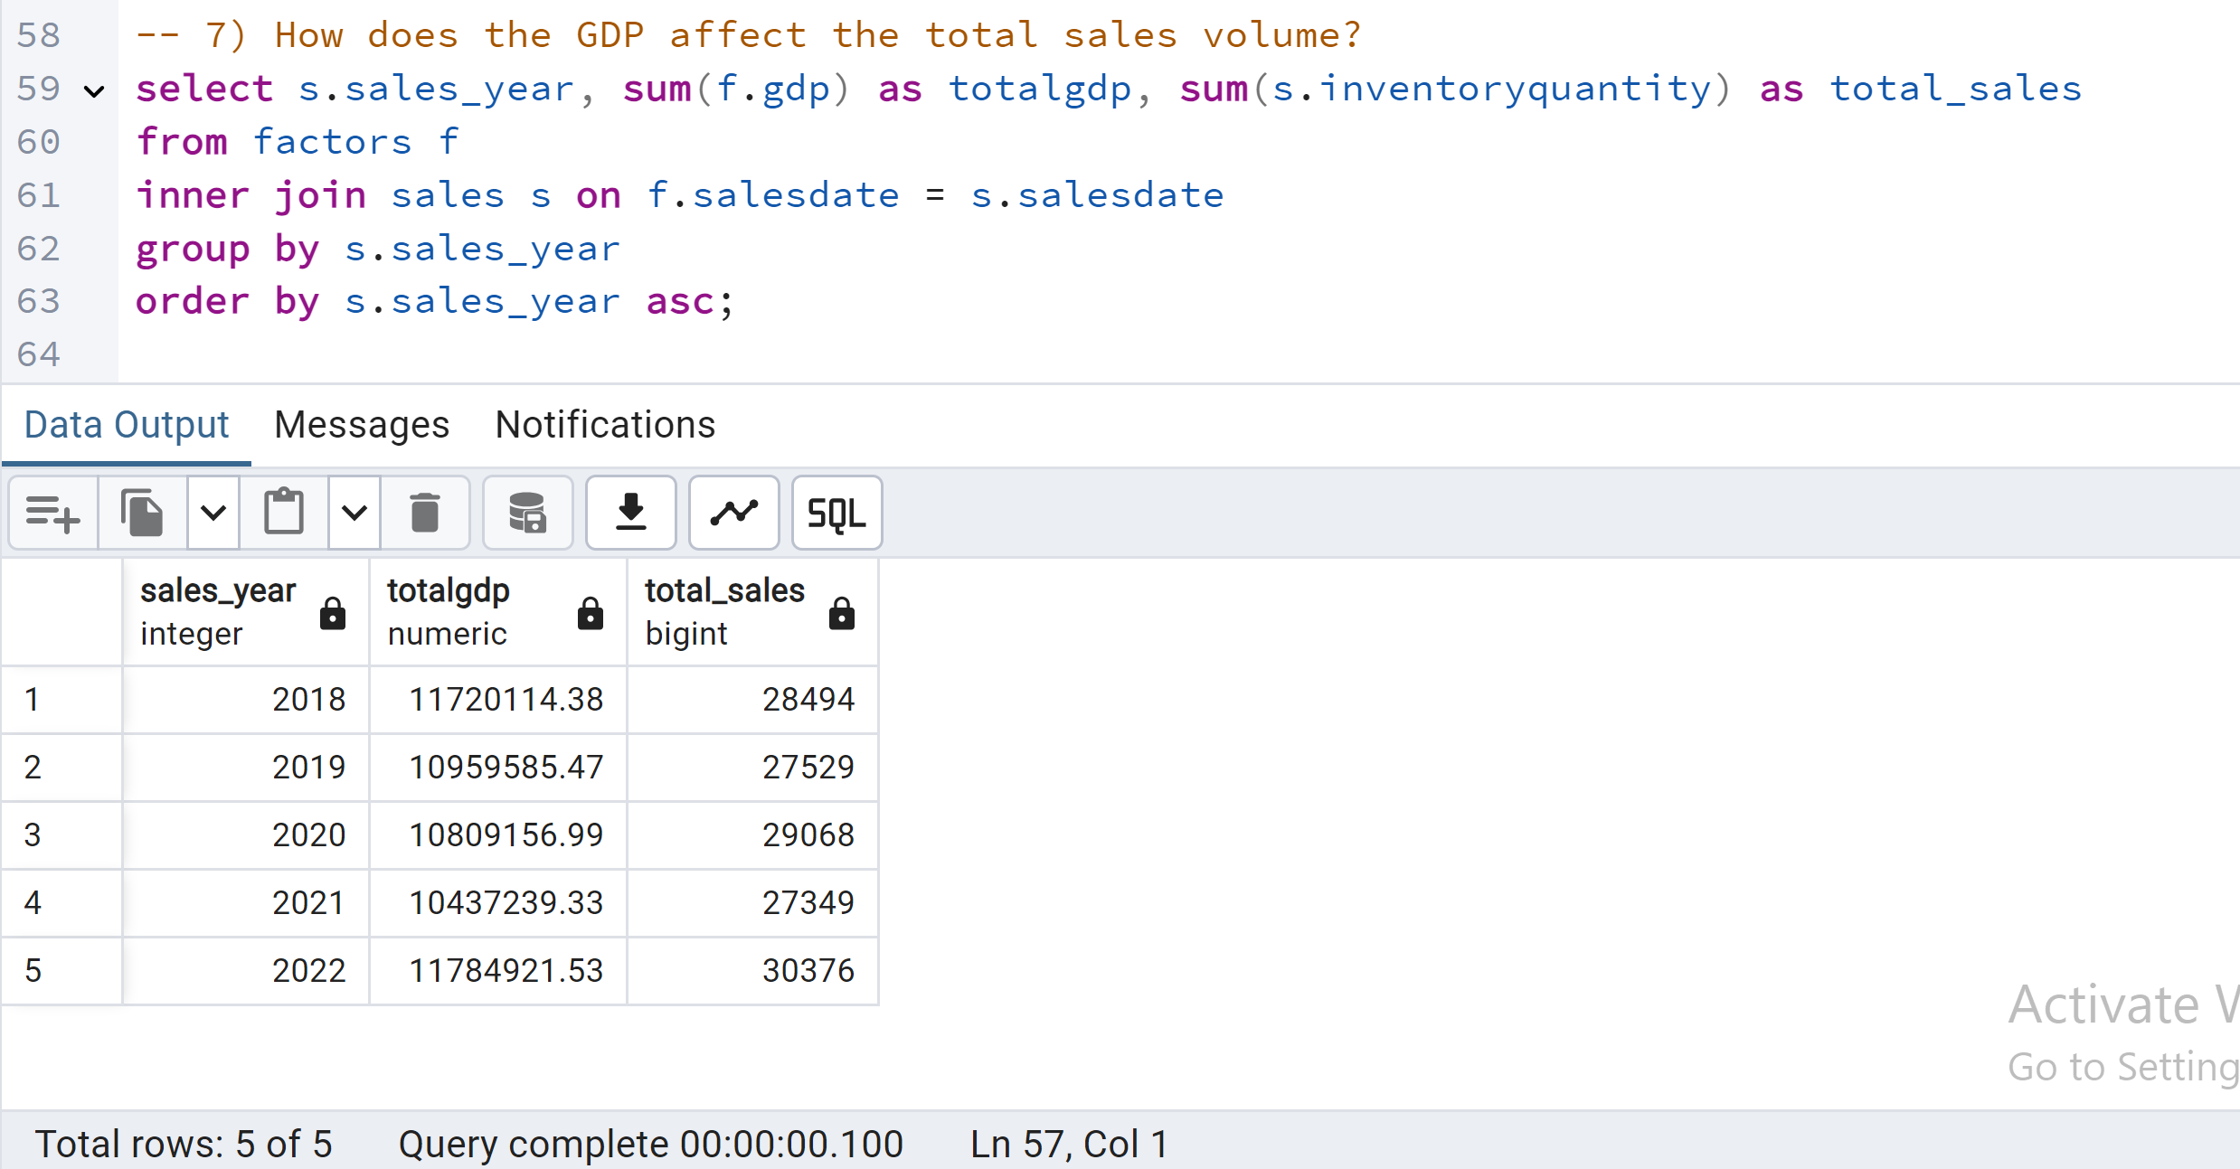
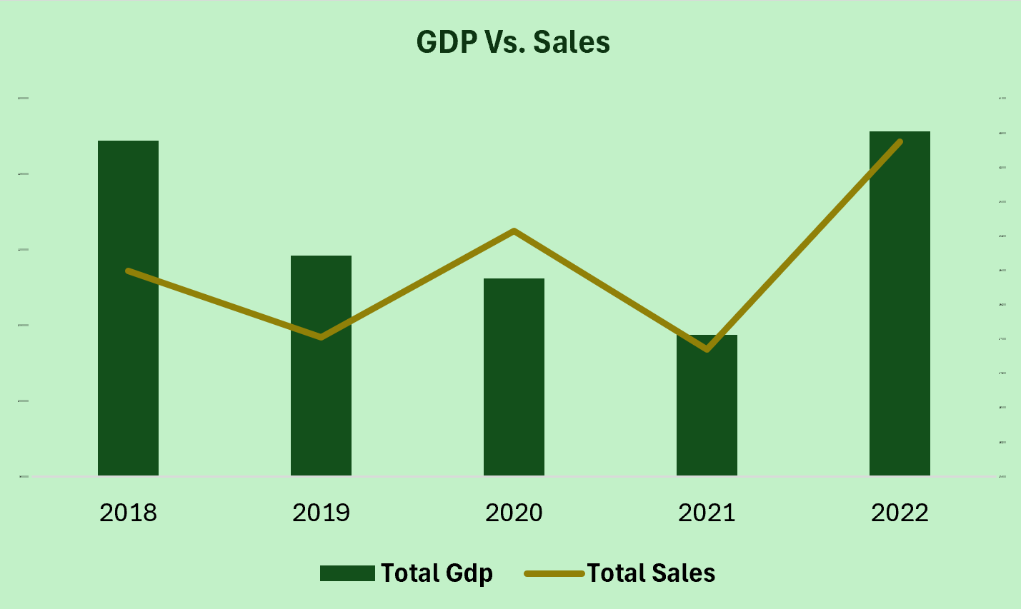
Question 7: How does the GDP affect the total sales volume?
Insights: There is a potential positive correlation between GDP and sales, but with inconsistencies. Other factors likely influence sales volume alongside GDP.
Recommendations: GDP may influence sales, but the relationship is complex. Further analysis considering additional economic indicators and time lags is crucial for understanding the true impact.

Slide 13
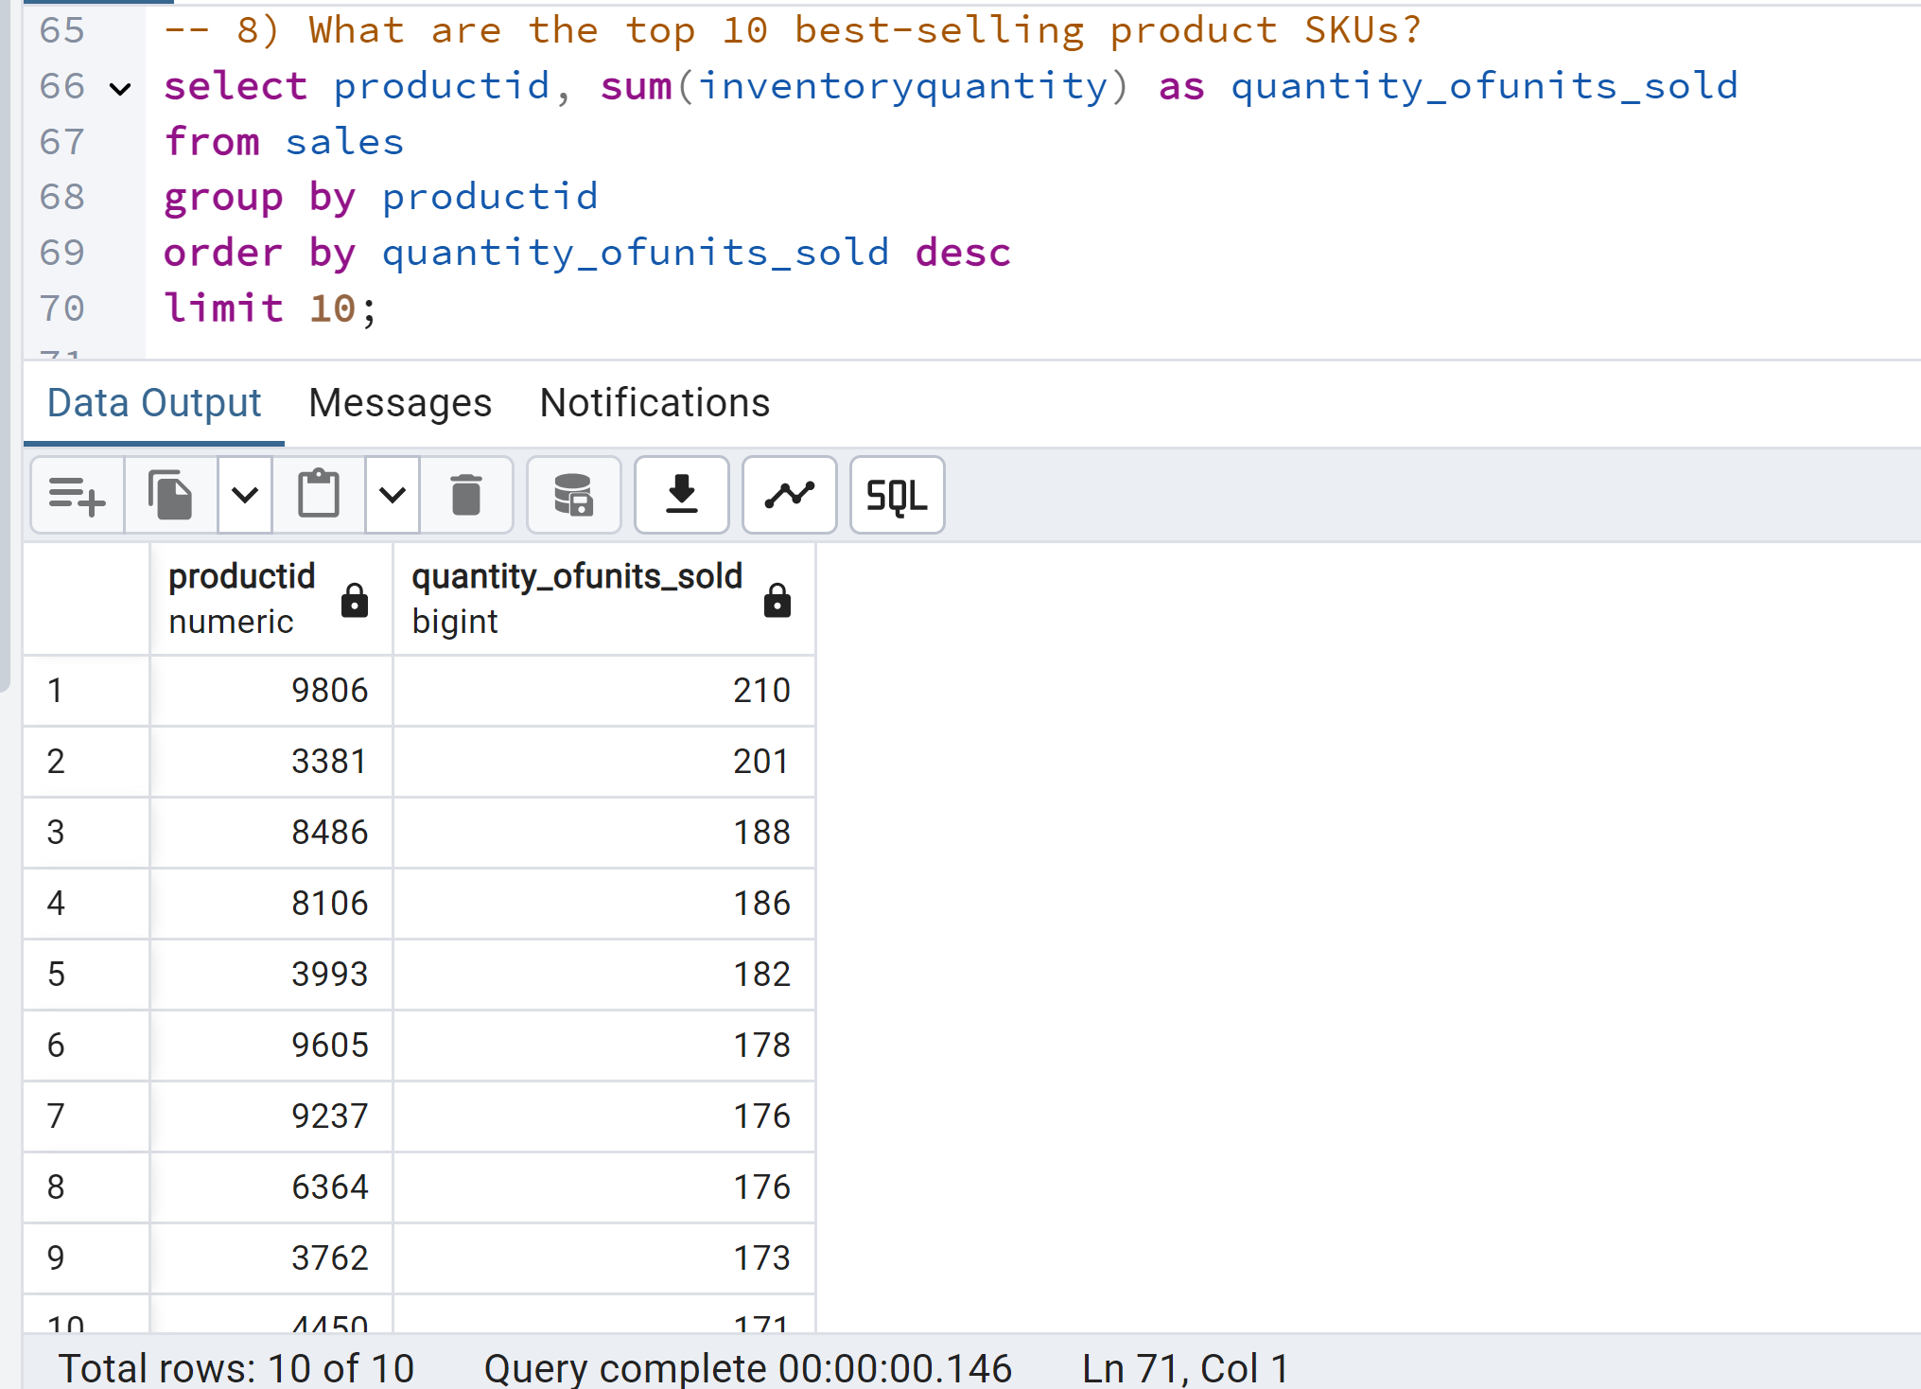
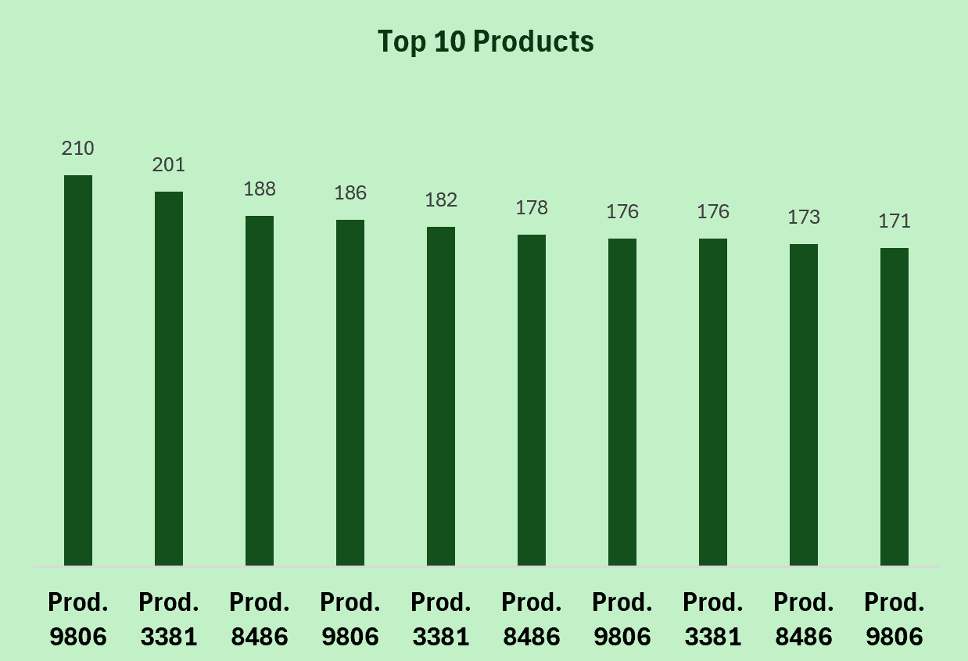
Question 8: What are the top 10 best-selling product SKUs?
Insights: (i) The top 10 products drive significant sales volume. (ii) Demand is concentrated among these key products.
Recommendations: (i) Prioritize inventory for top sellers to prevent stockouts. (ii) Closely monitor performance and address any sales declines. (iii) Optimize pricing and promotions for these products. (iv) Analyze customer feedback and reviews.

Slide 14
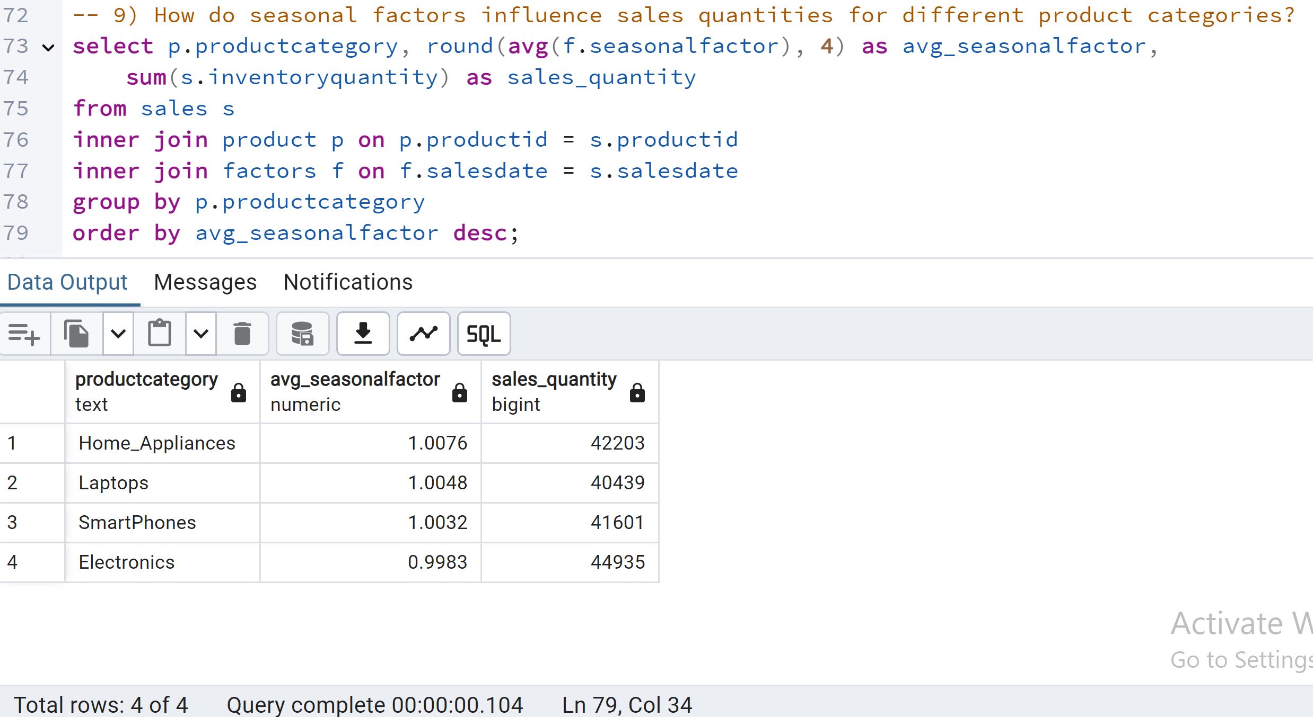
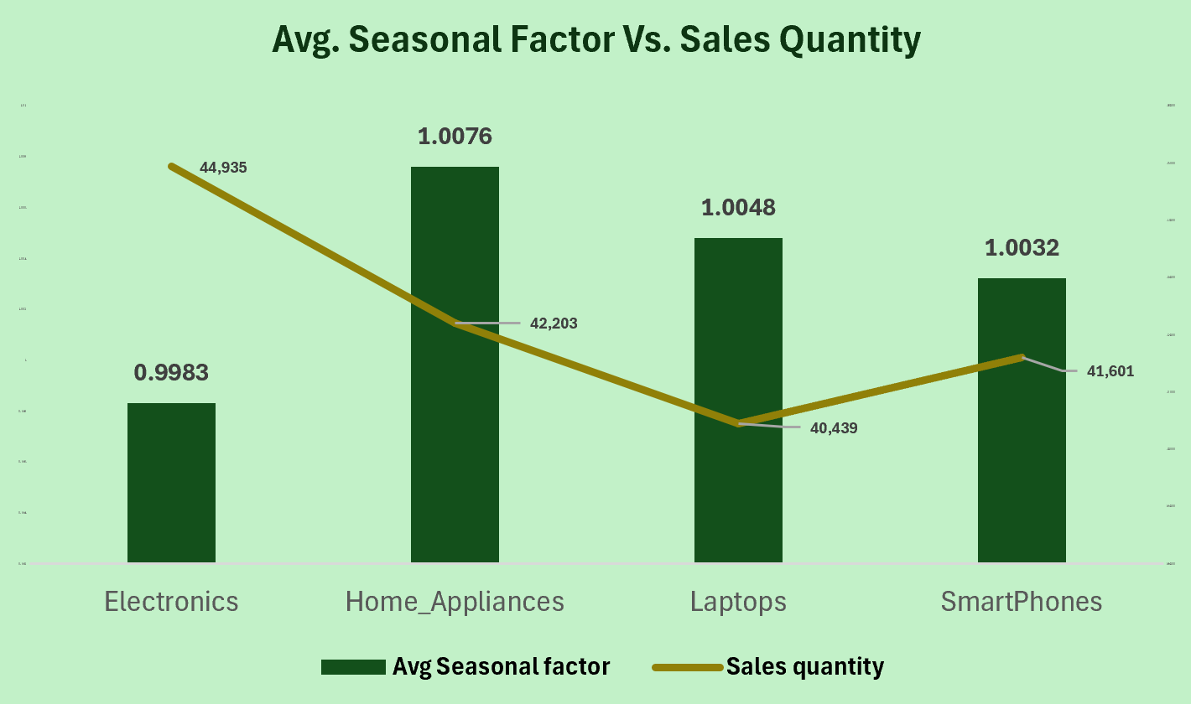
Question 9: How do seasonal factors influence sales quantities for different product categories?
Insights: (i) Minimal seasonal impact on sales quantities across categories. (ii) Slightly different trends for Home Appliances, Laptops, Smart phones.
Recommendations: (i) Investigate specific seasons linked to trends for targeted action. (ii) Consider combined seasonal/promotional effects.

Slide 15
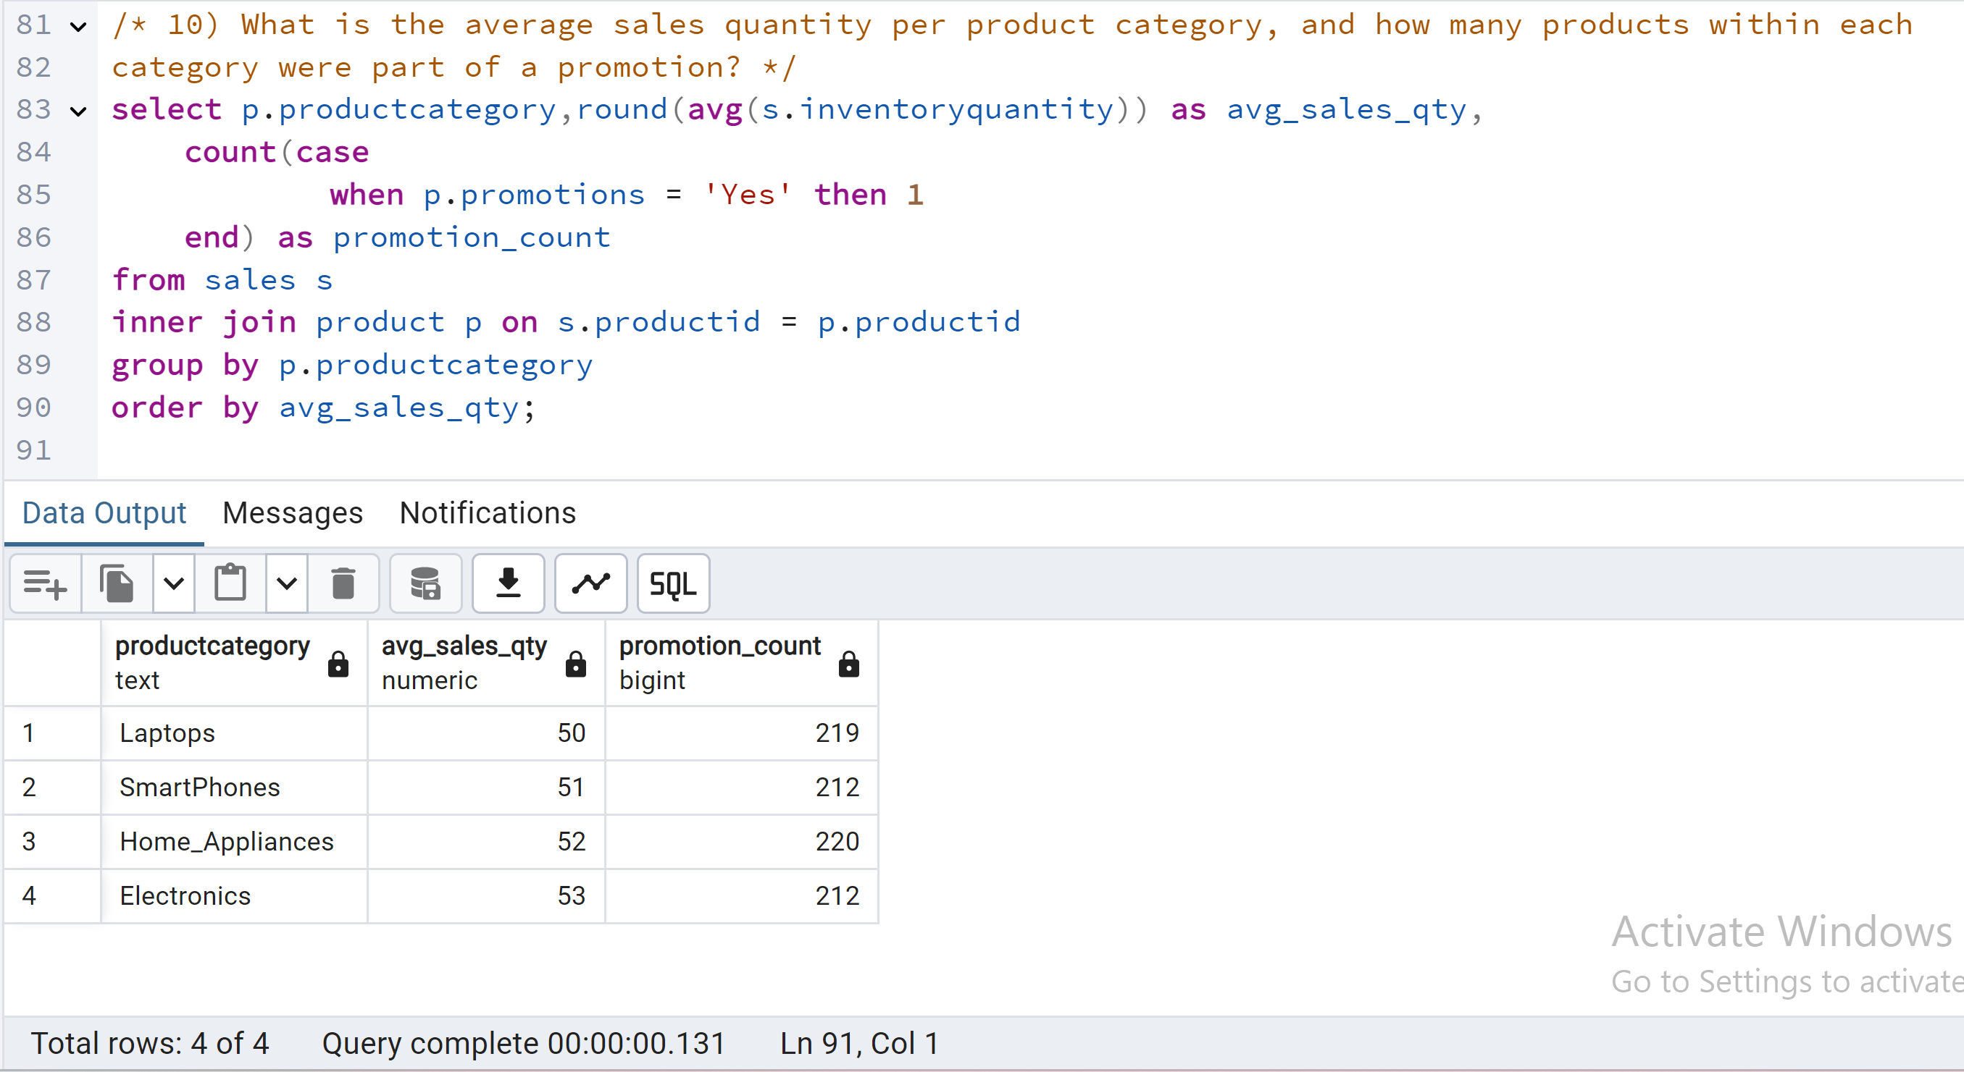
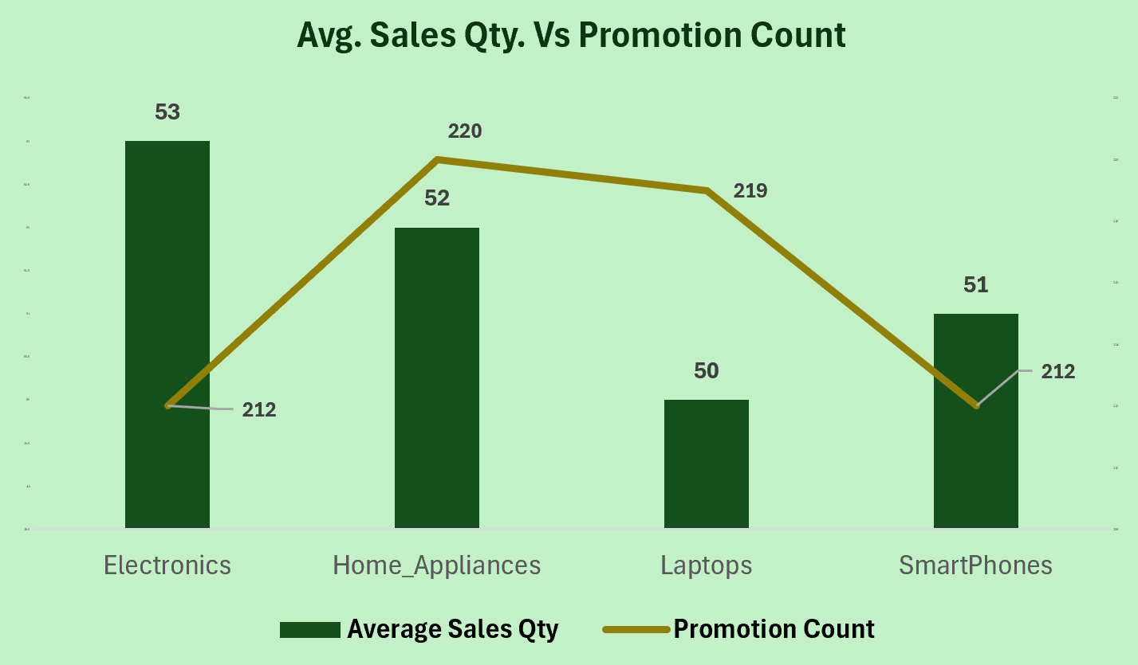
Question 10: What is the average sales quantity per product category, and how many products within each category were part of a promotion?
Insights: (i) Electronics lead in average sales quantity. (ii) Promotion counts vary across categories. (iii) Home Appliances' higher sales may be linked to higher promotion count.
Recommendations: (i) Optimize promotion strategies based on category response. (ii) Implement targeted promotions for specific categories. (iii) Balance promotions with inventory levels.

Slide 16
Action Plans
Inventory Optimization: (i) Prioritize Top Sellers: Focus inventory management on the best-selling SKUs. (ii) Accurate Forecasting: Improve demand forecasting using historical data, seasonality, and external factors. (iii) Minimize Stockouts: Establish safety stock levels for key products.
Targeted Sales & Marketing: (i) Leverage Top Performers: Boost marketing for top SKUs and categories (like Home Appliances). (ii) Category-Specific Promotions: Tailor promotions to each category's unique needs.
Operational Efficiency: (i) Streamline Inventory: Implement a warehouse management system. (ii) Optimize Supply Chain: Improve supplier relationships and delivery times.
Data-Driven Decisions: (i) Regular Data Analysis: Monitor key metrics and analyze sales trends. (ii) Utilize Data Analytics Tools: Leverage data to gain deeper insights and improve decision-making.

Slide 17
Conclusion
By prioritizing key products, optimizing inventory, and leveraging data-driven insights, TT Inc. can enhance operational efficiency, improve customer satisfaction, and achieve sustainable growth.
Thank you!!

